Slide 1
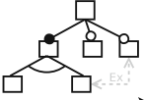

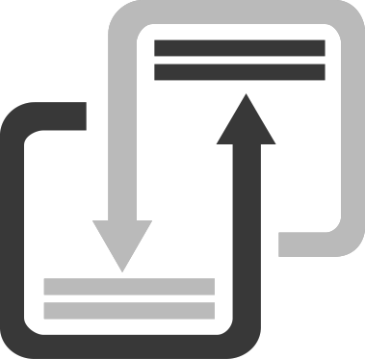
FOUNDRY: SPL Reengineering Approach via Software Transplantation
SPL via Software Transplantation
Pre-operative
Variant extraction
Product derivation
Legend
Seamless Variability Management (without annotation)
Donor preparation
?
Organ
Can be used both to extractive or reactive product line migration strategy
Over-organs
Compatibility Layer Definition
Inputs
A
B
Feature model
J
E
B
Process workflow
Can be used as a systematic Clone&own strategy to specialize existing products
C
D
Automated stage
System 1
E
Over-organs with a Compatibility Layer
﻿Avoiding the duplication of feature implementations
Donor Systems
ICE-BOX
B
E
F
Over-organ extraction
IceBox Tests
Post-operative test cases
﻿Preserving features behavior
﻿Reduce feature redundancy
Automated ﻿ changes propagation
G
H
Over-organ
reduction and adaptation
System 2
I
J
Codebase and organ entry point
J
E
B
Post-operative
L
M
Over-organ
Repository
E
System 3
B
Host preparation
Host insertion point
Organ implantation
E
B
B
A
B
W
Z
Product base (Host)
A
B
A
Product 1
X
K
W
Z
B
E
W
Z
Product Base
W
Z
B
A
B
System 4
Product Base
W
Z
Product 2
…
Feature selection

